Slide 1
Auburn-USDA CS Clinic
Liaison Meeting (1/30/25)

Slide 2
Progress

Slide 3
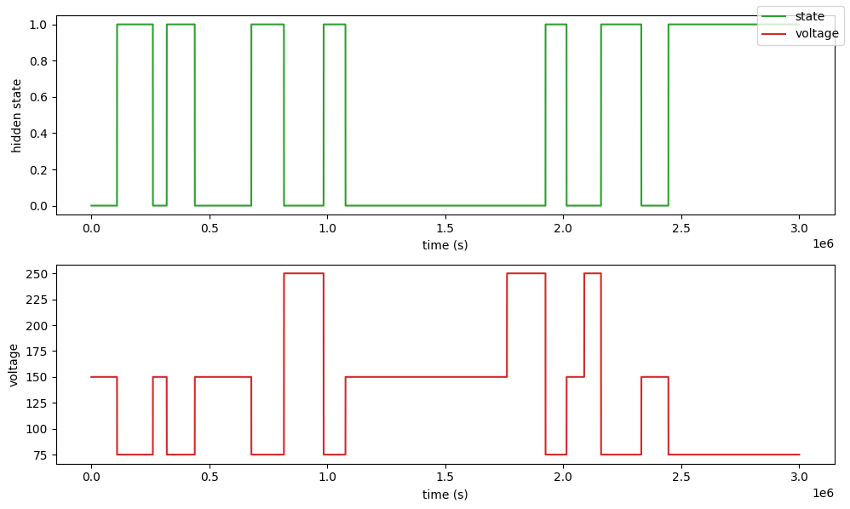
Hidden Markov Models
The hidden state somewhat matches the voltage time series, but there are still discrepancies!

Slide 4
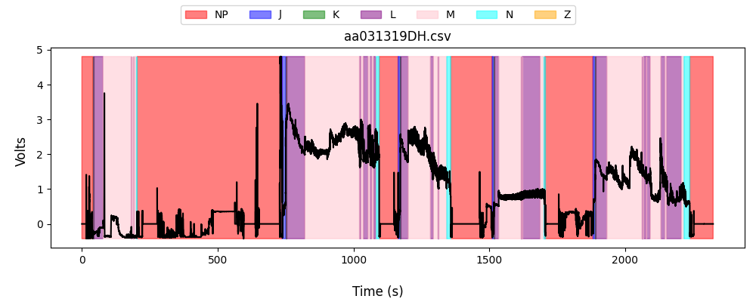
Aedes aegypti Data
Finished cleaning data, so we can begin using it
Filled discontinuities with NP

Slide 5
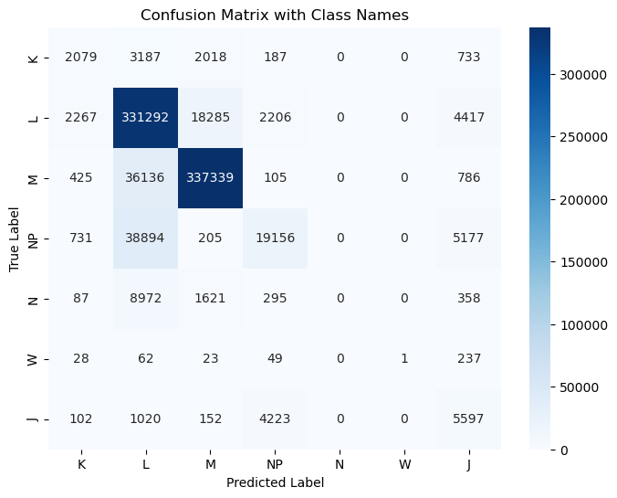
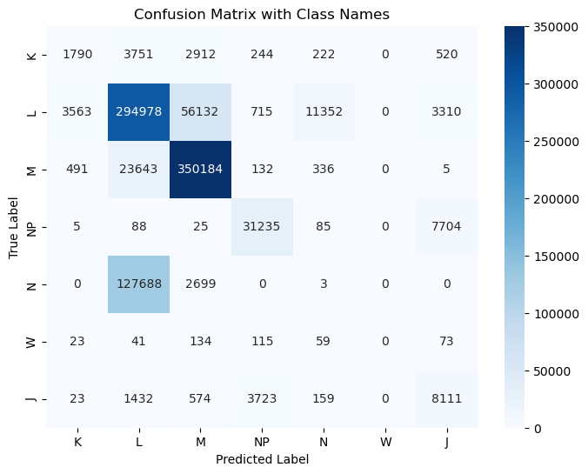
Probe Splitting
OLD NEW

Slide 6
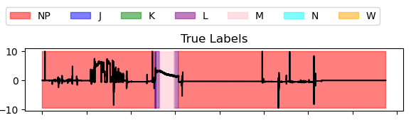
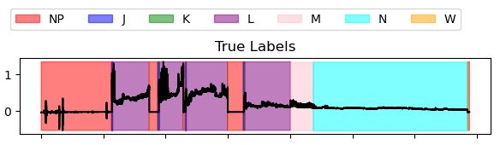
Some weird data things
handcxt3aug2021.csv
cxtonhandkscage9mar2022no7.csv

Slide 7
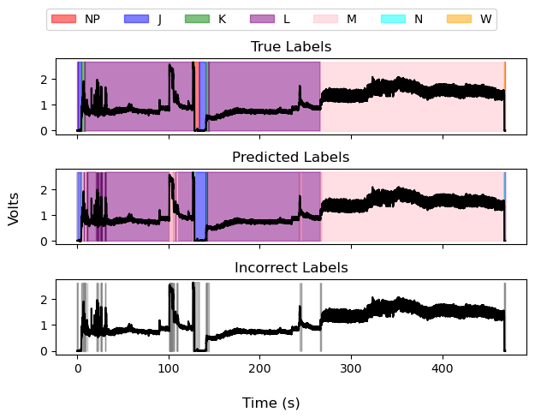
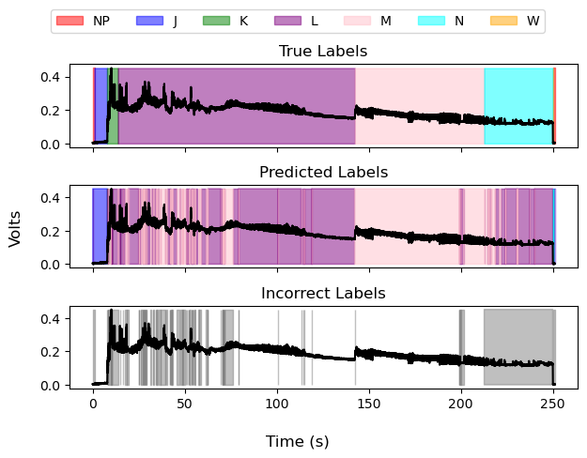
Deep Learning Result Visualizations (UNet) (no preprocess)

Slide 8
Deep Learning Result Visualizations (UNet) (no preprocess)

Slide 9
Deep Learning Result Visualizations (UNet) (no preprocess)

Slide 10
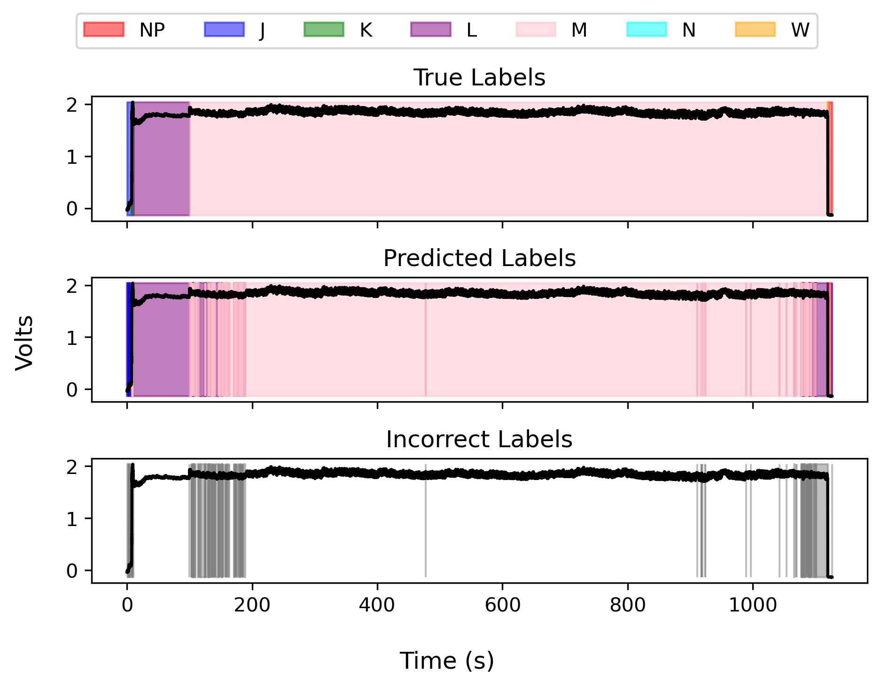
Deep Learning Result Visualizations (UNet) (yes preprocess)

Slide 11
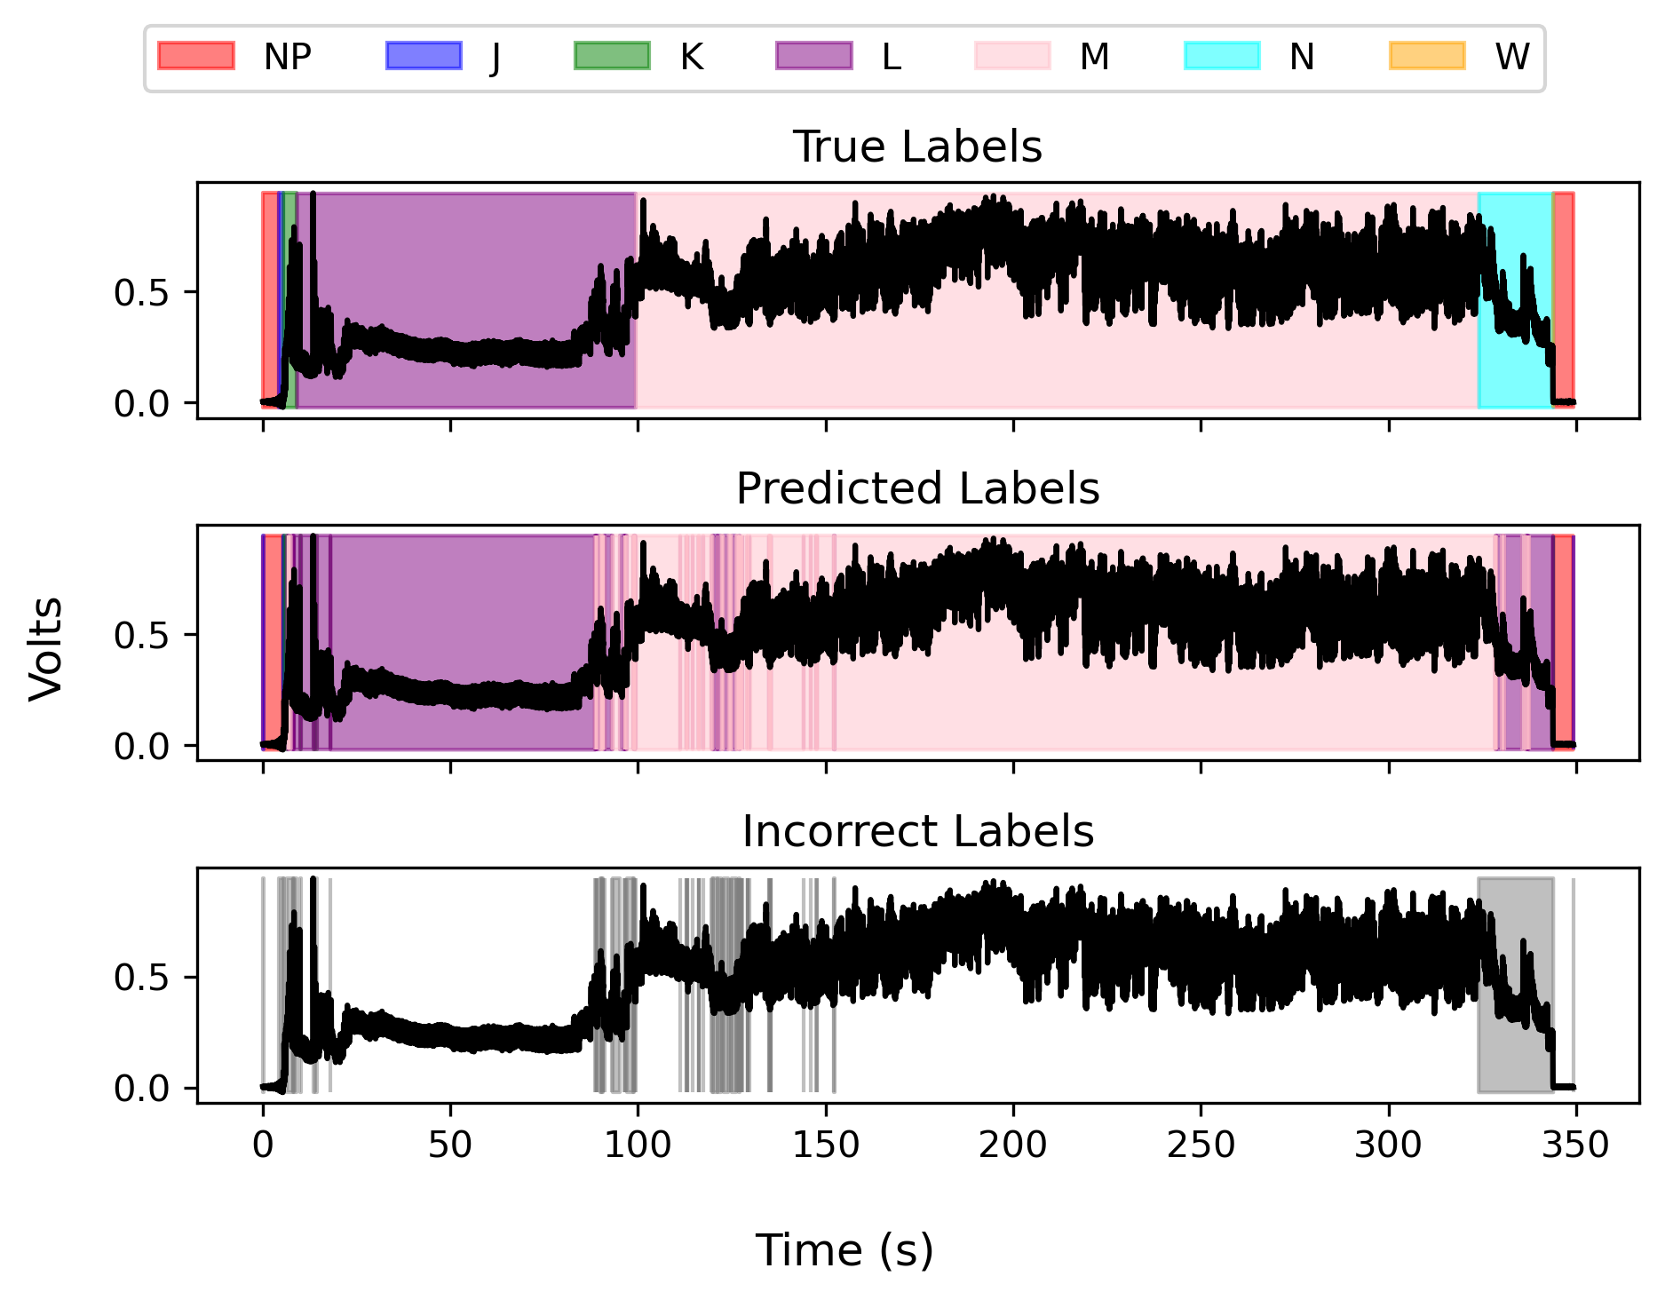
Deep Learning Result Visualizations (UNet) (yes preprocess)

Slide 12
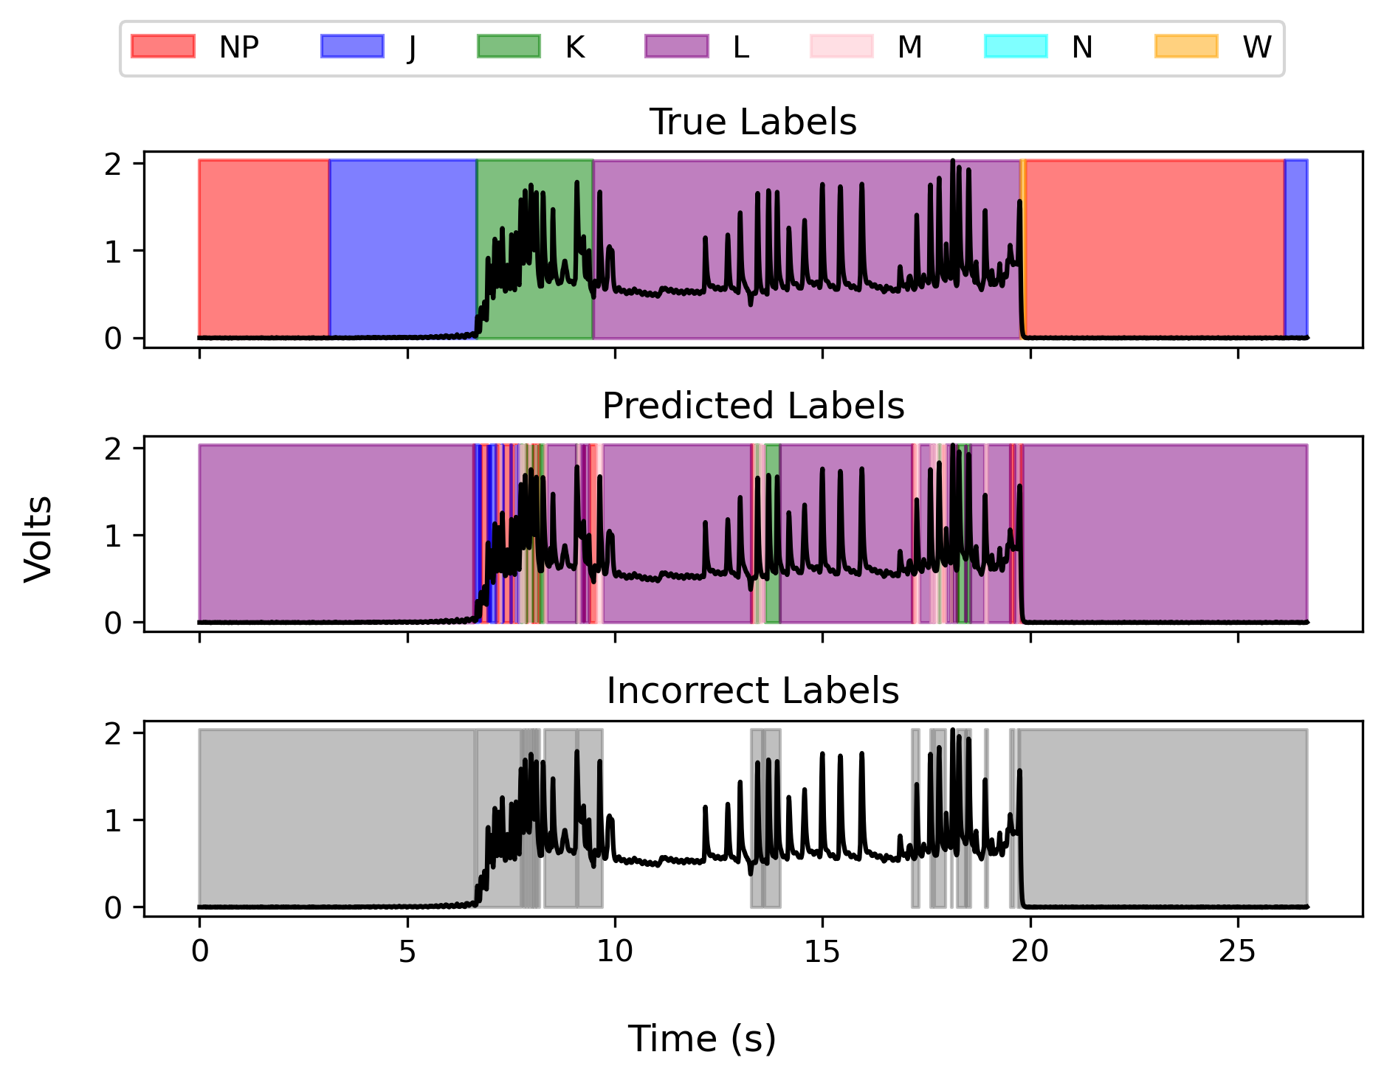
Deep Learning Result Visualizations (UNet) (yes preprocess)

Slide 13
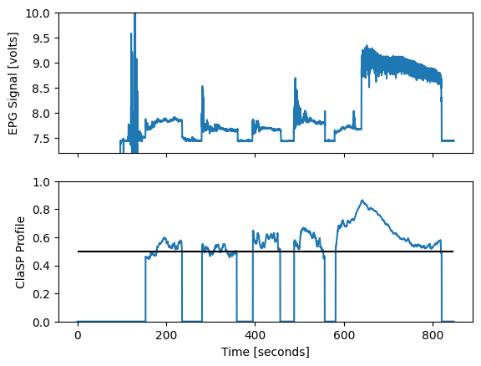
ClaSP Integration
Example of EPG and ClaSP
ClaSP Profile is a ROC AUC score
Conveys how well a simple model can distinguish between the data before and after that time point
0.5: Pure guessing
1.0: Perfectly correct
Notes:
We set the ClaSP Profile to 0 outside of probes
Why use ClaSP like this?
Peaks in the ClaSP Profile generally correspond to transitions, we hope this additional information can improve model performance

Slide 14
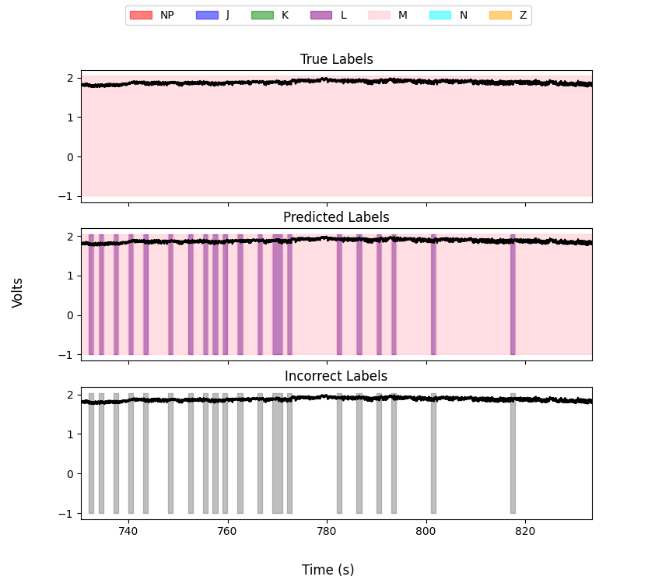
Post-processing
Barcoding (see example at right)
Methods to fix this will likely involve replacing short labels with that of the labels surrounding them
Should improve performance, experiments pending
Will also make it easier for a human to modify after the fact
No need to delete hundreds of short errors!
Impossible Transitions: planning on adding an indicator in the GUI to flag these for inspection.

Slide 15
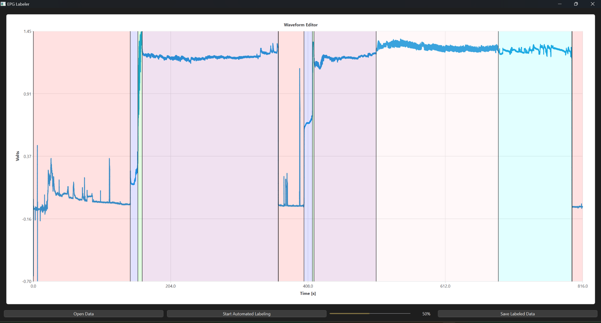
GUI Demonstration

Slide 16
Travel Confirmation
Monday 3rd March afternoon to Wednesday 5th March evening

Slide 17
Publication Discussion

Slide 18
